Slide 1
TASK 2
Predicting customer buying behaviour
Forage Data Science Project

Slide 2
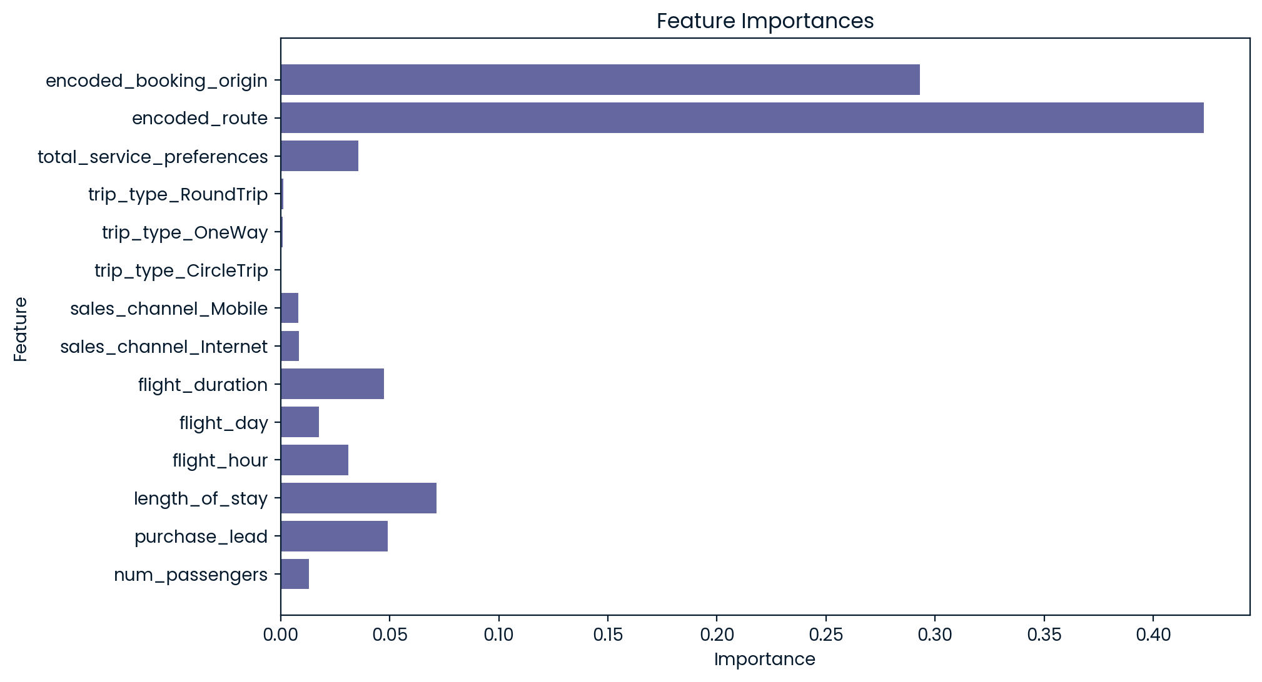
Feature Importances
Correlation:
encoded_route: 0.48
encoded_booking_origin: 0.42
total_service_preferences: 0.06
flight_duration: -0.15

Slide 3
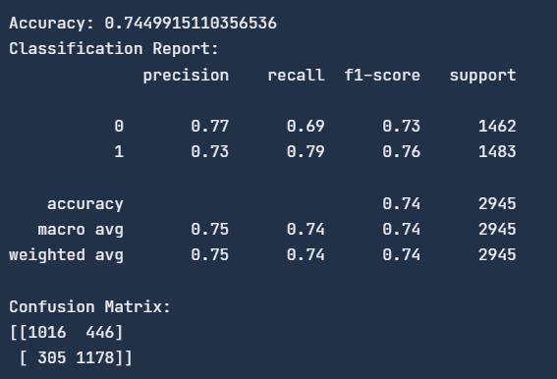
Model Evaluation
This model can get a significant enhancement. (e.g. by incorporating additional customer focused features)

